Slide 1
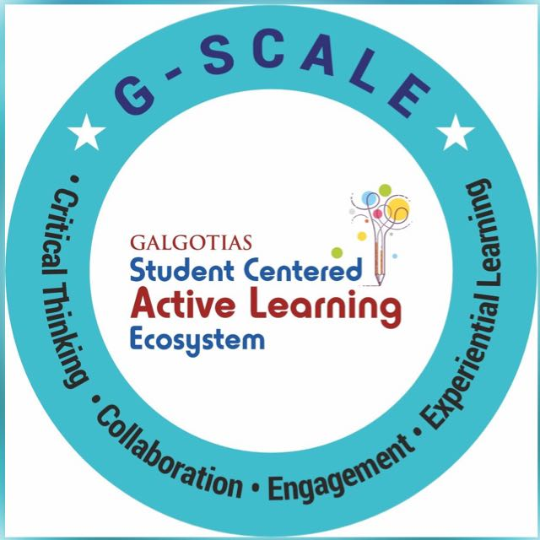
Conditional Statements & Loops
Course Name: Python Programming
Course Code: - E1UA311C
Instructor Name: Pooja Vajpayee
Duration: 50 Mins

Slide 2


Review of the key concepts of last session
Python is a high-level, interpreted, and easy-to-learn programming language.
2. Names used for variables, functions, and classes, following specific naming rules.
3. Containers for storing data, dynamically typed without explicit declaration.
4. Perform mathematical operations like

Slide 3
💡 "How would you print numbers from 1 to 10 "

Slide 4
At the end of this session students will be able to
Learning Outcome 1 : Apply conditional statements (if, elif, else) to control program flow based on different conditions.
Learning Outcome 2: Use loops(for & while) and loop control statements (break, continue) for efficient iteration and execution.

Slide 5
Session Outline
1. Introduction to Python Language.
2 . Opening and Learning Outcomes.
3. Conditional statements in Python.
4. A1 ( Fill the blanks):
5. Loops in Python.
6 . A2 (Short Answers):
7. Conclusion & Closure

Slide 6

Conditional Statements in Python?
Conditional execution in Python allows you to run specific blocks of code based on certain conditions using if, elif, and else statements. Here’s how it works:
if statements :
x = 10
if x > 5:
print("x is greater than 5")
if-else statement :
x = 3
if x > 5:
print("x is greater than 5")
else:
print("x is not greater than 5")

Slide 7
if-elif-else statements :
x = 10
if x < 5:
print("x is less than 5")
elif x == 10:
print("x is exactly 10")
else:
print("x is greater than 5 but not 10")
nested if statements :
x = 10
if x > 5:
print("x is greater than 5")
if x % 2 == 0:
print("x is even")

Slide 8

if as a ternary operator :
x = 10
result = "Even" if x % 2 == 0 else "Odd"
print(result)
Conditional operators in if statements :
x = 10
y = 5
if x > 5 and y < 10:
print("Both conditions are True")
if x > 15 or y < 10:
print("At least one condition is True")
if not x == 5:
print("x is not equal to 5")

Slide 9
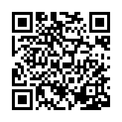
Learning Activity 1

Slide 10
Loops in Python : Used to iterate over a sequence (list, tuple, string, dictionary, range etc).
Loops in Python allow you to execute a block of code multiple times. Python supports two main types of loops :
1. for loops
2. while loops
for i in range(5): # Iterates from 0 to 4
print(i)
for char in "Python":
print(char)

Slide 11
Using break in for loop
for i in range(10):
if i == 5:
break # Stops when i is 5
print(i)
using continue in for loop
for i in range(5):
if i == 2:
continue # Skips 2
print(i)

Slide 12
while loops : Executes as long as a condition remains true.
x = 0
while x < 5:
print(x)
x += 1
------------------------------------------------- Using break in while loops
x = 0
while x < 10:
if x == 5:
break # Stops loop when x is 5
print(x)
x += 1

Slide 13

using continue in while loops
x = 0
while x < 5:
x += 1
if x == 3:
continue # Skips the rest of the loop for x = 3
print(x)

Slide 14
Nested for loop
for i in range(3):
for j in range(2):
print(f"i = {i}, j = {j}")

Slide 15
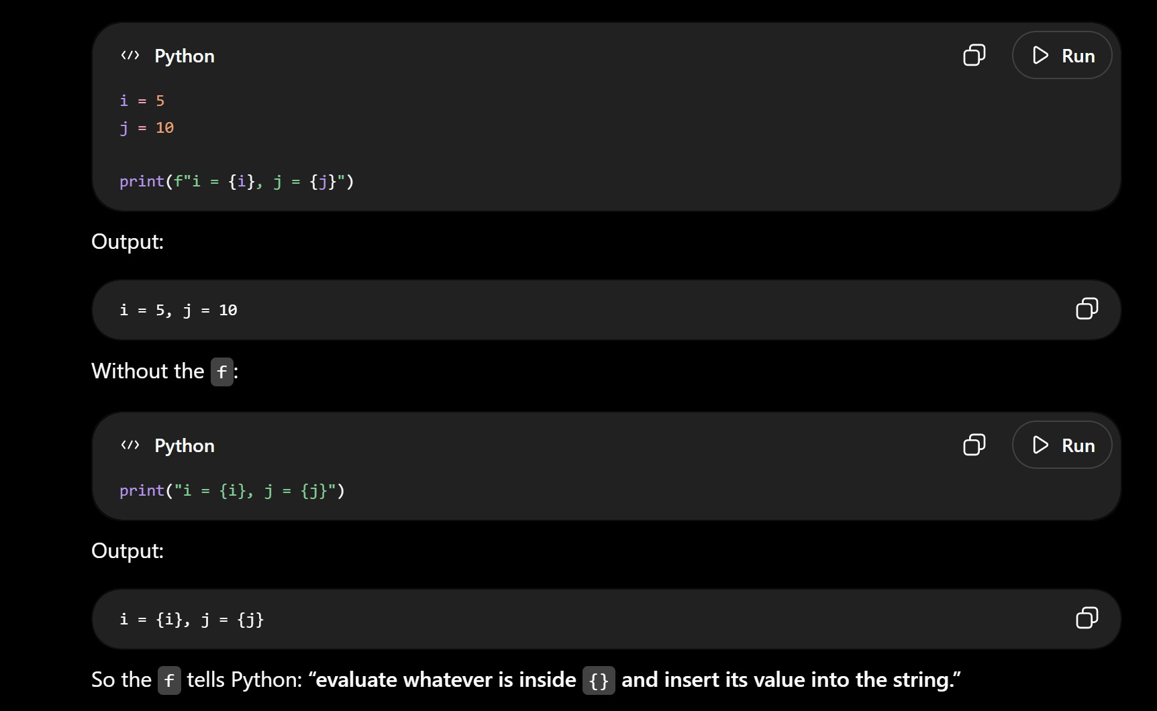
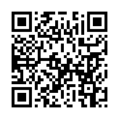
Learning Activity 2

Slide 16
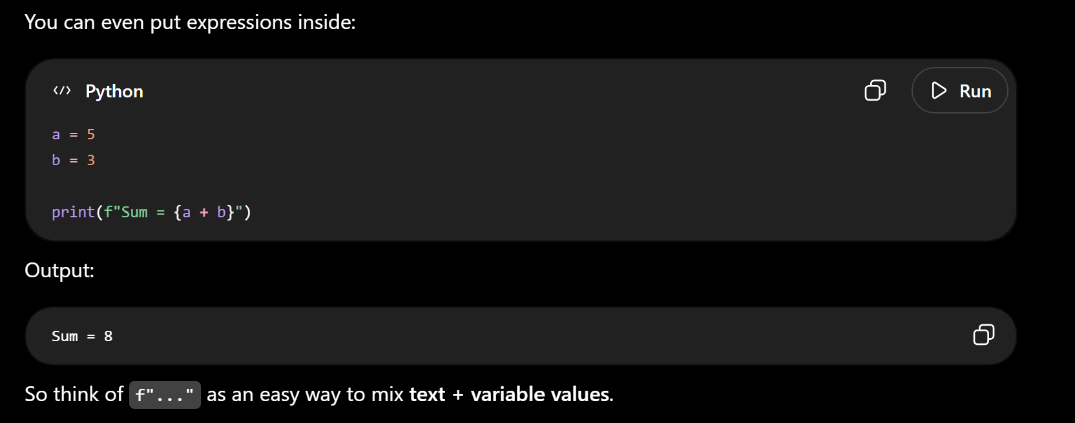
Conclusions-
✅ Conditional statements (if , elif , else) control execution based on conditions.
✅ Loops (for & while) help iterate over sequences or run while a condition is true.
✅ “break” & “continue“ modify loop execution flow..
✅ Start coding and explore Python further!

Slide 17
Now Students are able to :
Learning Outcome 1 : Apply conditional statements (if, elif, else) to control program flow based on different conditions.
Learning Outcome 2: Use loops(for & while) and loop control statements (break, continue) for efficient iteration and execution.

Slide 18

post session activities
* Attempt the Post-session activity on LMS, before next session.

Slide 19
Next session:
List, Dictionary, Tuple

Slide 20

Thank You

